Slide 1
A Christian Perspective on Origins: A Plea for Civility
© Dr. John Robert Schutt
Taylor University Fort Wayne

Slide 2
A Few Background Statements
1. A Disclaimer:
The views and opinions expressed in this presentation are those of the presenter and do not necessarily represent the views and opinions of God.

Slide 3
A Few Background Statements
2. Think of this talk as a primer.

Slide 4
A Few Background Statements
3. This topic is not one of the essentials of the faith.
Disputable
Matters
Secondary
Doctrines
Essentials

Slide 5
A Few Background Statements
4. In my opinion, it is important to know the academic background of the author/presenter
Notes:
It’s important to know the background of the person who is writing on origins. There are lots of people out there who write on this topic and who simply do not have the science background to do so. I think that a person should have a minimum of a master’s degree from an accredited university in a related science content area to write on this topic. Check out people’s credentials and you’ll find that people often do not have the background that they should have.

Slide 6
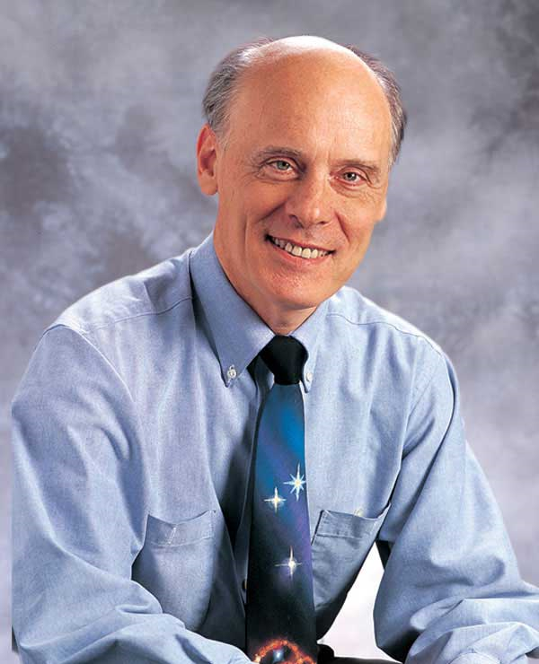
Education:
University: BSc Physics, University of British Columbia
University: MSc Astronomy, University of Toronto
University: PhD Astronomy, University of Toronto
Postdoctoral Research Fellow: Caltech, studying quasars and galaxies.
Hugh Ross

Slide 7
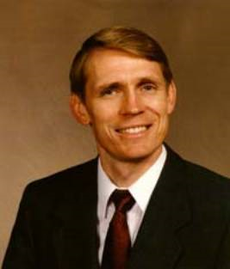
Education:
High School: East Peoria High School, East Peoria, IL (1971)
University: Illinois Central College (1972, dropped out)
University: BA Religious Education, Midwestern Baptist College (1974)
University: MA Christian Education, Patriot University (1988)
University: PhD Christian Education, Patriot University (1991)
What is his science education?
“Dr. Dino”
Kent Hovind

Slide 8
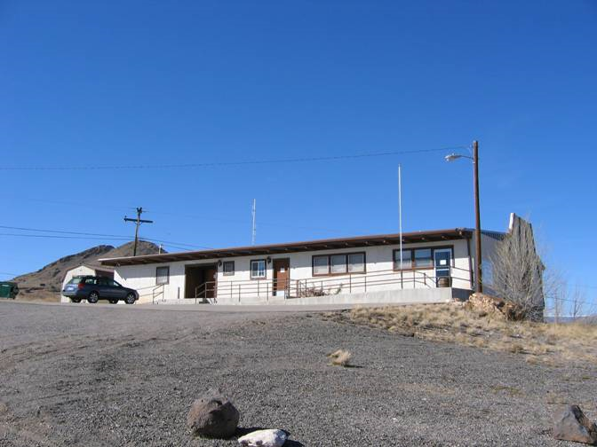
“Dr. Dino”
Kent Hovind
Front view of the Patriot Bible University in Del Norte, Colorado taken on November 22, 2006.

Slide 9
Patriot Bible University
Founded 1979 in Dallas, Texas.
Listed as a Christian diploma mill in Steve Levicoff's Name It and Frame It? New Opportunities in Adult Education and How to Avoid Being Ripped Off by "Christian" Degree Mills (1995).
“Dr. Dino”
Kent Hovind

Slide 10
Patriot Bible University
Lack of accreditation. This institution is not accredited by standard accreditation bodies -- those recognized by the Council for Higher Education Accreditation. Instead, it sports an "accreditation" from the American Accrediting Association of Theological Institutions, which for $100 will issue "credentials" for an institution that could not pass muster under CHEA guidelines.
“Dr. Dino”
Kent Hovind

Slide 11
Kent Hovind … was convicted of federal tax offenses and related charges, for which he is currently serving a 10-year sentence.
http://en.wikipedia.org/wiki/Kent_hovind
“Dr. Dino”
Kent Hovind

Slide 12
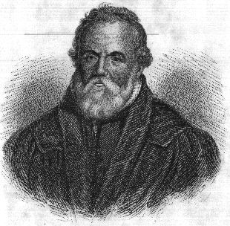
“There but for the grace of God, go I.”
(The original is, “There but for the grace of God, goes John Bradford.”)
John Bradford
(1510 - 1555)

Slide 13
A Few Background Statements
4. In my opinion, it is important to know the academic background of the author/presenter
Who is Dr. Schutt?
Christian testimony:
Growing up…
I love Jesus! I am one of His children.
Science training
BA, Biology, McDaniel College
MA, Botany, The University of Tennessee, Knoxville
Ph.D., Ecology, The University of Tennessee, Knoxville
Notes:
It’s important to know the background of the person who is writing on origins. There are lots of people out there who write on this topic and who simply do not have the science background to do so. I think that a person should have a minimum of a master’s degree from an accredited university in a related science content area to write on this topic. Check out people’s credentials and you’ll find that people often do not have the background that they should have.

Slide 14
A Few Background Statements
5. I think that this is a topic where VERY FEW people change their mind.
I think that, typically, discussions generate more heat than light.
After brief early exposure to the topic, people often suffer from “hardening of the categories.”

Slide 15
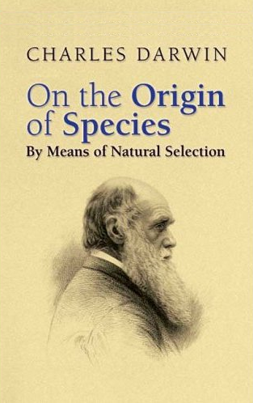
A Few Background Statements
6. I have a question for you. . . .
How many of you have ever read (at least an abridged version of) Darwin’s Origin of Species?
Many/most Christians that I know are “against” Darwin. I find few Christians who have actually read his work.
Notes:
Have you read the Origins? Do you talk about Darwin without having ever read him? How can that be? You really should stop talking about him until you have at least read an abridged version of the Origins. I’m not talking about reading ABOUT Darwin – I’m talking about reading his work.

Slide 16
How do Christians Usually Present the Topic of Origins?
Evolution
Creationism
Science
God/ the Bible
Scientists
(Pagan atheists)
Believers
Bad guys
Good guys
It is my opinion that when Christians portray the topic of origins this way, they are simply driving the wedge between God and unbelievers. People who do this are putting stumbling blocks in front of unbelievers.
Notes:
This is the way that the “debate” is usually presented in Christian circles. It’s presented as if there are only two sides: the “true” young-earth creationist, bible-believers and those pagan scientists. This is a shame on Christianity. This does not represent the area at all.
I am a scientist. I am a Christian. I affirm that God made all. That fact is clearly taught in Scripture. I am deeply offended at “believers” who equate science with paganism.

Slide 17
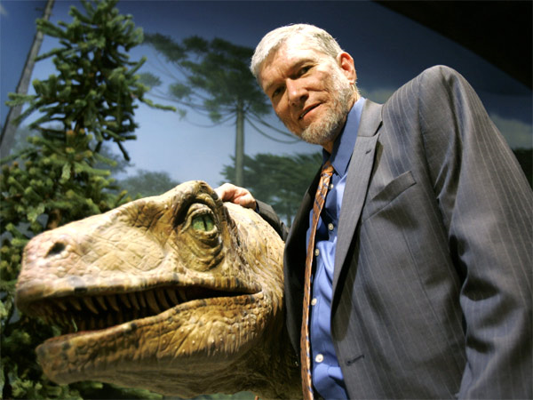
Who should you always trust first, God, or the scientists?
Ken Ham
Bachelor‘s, Applied Science , Queensland Institute of Technology
Diploma of Education, University of Queensland

Slide 18
Augustine (November 13, 354 – August 28, 430), The Literal Meaning of Genesis, translated and annotated by John Hammond Taylor, S.J., 2 vols. (New York: Newman Press, 1982).
Usually, even a non-Christian knows something about the earth, the heavens, and the other elements of this world, about the motion and orbit of the stars and even their size and relative positions, about the predictable eclipses of the sun and moon, the cycles of the years and seasons, about the kinds of animals, shrubs, stones, and so forth, and this knowledge he holds to as being certain from reason and experience.

Slide 19
Augustine, The Literal Meaning of Genesis, translated and annotated by John Hammond Taylor, S.J., 2 vols. (New York: Newman Press, 1982).
Now, it is a disgraceful and dangerous thing for an infidel to hear a Christian, presumably giving the meaning of Holy Scripture, talking nonsense on these topics; and we should take all means to prevent such an embarrassing situation, in which people show up vast ignorance in a Christian and laugh it to scorn.

Slide 20
Augustine, The Literal Meaning of Genesis, translated and annotated by John Hammond Taylor, S.J., 2 vols. (New York: Newman Press, 1982).
The shame is not so much that an ignorant individual is derided, but that people outside the household of the faith think our sacred writers held such opinions, and, to the great loss of those for whose salvation we toil, the writers of our Scripture are criticized and rejected as unlearned men....

Slide 21
Augustine, The Literal Meaning of Genesis, translated and annotated by John Hammond Taylor, S.J., 2 vols. (New York: Newman Press, 1982).
… Reckless and incompetent expounders of Holy Scripture bring untold trouble and sorrow on their wiser brethren when they are caught in one of their mischievous false opinions and are taken to task by these who are not bound by the authority of our sacred books.

Slide 22
Augustine, The Literal Meaning of Genesis, translated and annotated by John Hammond Taylor, S.J., 2 vols. (New York: Newman Press, 1982).
For them, to defend their utterly foolish and obviously untrue statements, they will try to call upon Holy Scripture for proof and even recite from memory many passages which they think support their position, although they understand neither what they say nor the things about which they make assertion. (pp. 42-43)

Slide 23
There is a Better Way to Talk about Origins!
To start, separate the worldview question of the “Who?” of creation from the science question of the “How?” of creation.
Notes:
We need to understand the situation better. The first distinction that we should make is that there is a difference in questions of the “Who” of creation and the “How” of creation. They are two separate questions. To discuss the topic of origins, we first have to discuss the “Who” of creation.
Two of the many worldviews are naturalism and theism. Evolutionism, like any other “ism,” is a worldview. It is a subset of the larger worldview called naturalism -- the worldview that states that only matter/energy exist. It denies the existence of a spiritual world. Clearly a naturalist has ONLY natural mechanisms to account for the presence of the creation. Indeed, for the naturalist, this is not a “creation” because there is no Creator. If a person does not believe in the existence of God, then you really have no common ground to discuss the topic of origins. You cannot discuss “How” God made the creation. With a non-Christian, focus on the person and work of Jesus.

Slide 24
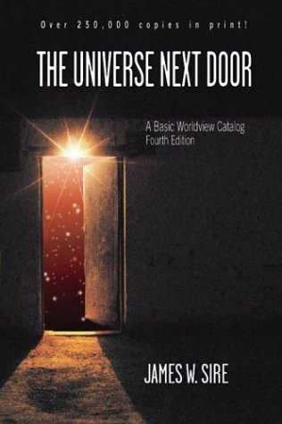
“A worldview is a commitment, a fundamental orientation of the heart, that can be expressed as a story or in a set of presuppositions (assumptions that may be true, partially true, or entirely false) which we hold (consciously or unconsciously, consistently or inconsistently) about the basic constitution of reality, and that provides the foundation on which we live and move and have our reality.”

Slide 25
Worldviews covered in this book:
Theism
Deism
Naturalism
Nihilism
Existentialism
New Age philosophy
Marxism
Secular humanism
Postmodernism

Slide 26
With Unbelievers, Talk about the “Who” of Creation – Not the “How”
Evolutionism (worldview)
Like any other “ism,” it is a worldview.
Evolutionism is a subset of naturalism.
Notes:
We need to understand the situation better. The first distinction that we should make is that there is a difference in questions of the “Who” of creation and the “How” of creation. They are two separate questions. To discuss the topic of origins, we first have to discuss the “Who” of creation.
Two of the many worldviews are naturalism and theism. Evolutionism, like any other “ism,” is a worldview. It is a subset of the larger worldview called naturalism -- the worldview that states that only matter/energy exist. It denies the existence of a spiritual world. Clearly a naturalist has ONLY natural mechanisms to account for the presence of the creation. Indeed, for the naturalist, this is not a “creation” because there is no Creator. If a person does not believe in the existence of God, then you really have no common ground to discuss the topic of origins. You cannot discuss “How” God made the creation. With a non-Christian, focus on the person and work of Jesus.

Slide 27
With Unbelievers, Talk about the “Who” of Creation – Not the “How”
Naturalists, by definition, deny God’s existence.
You will never convince a naturalist of any creationist view on origins.
Notes:
We need to understand the situation better. The first distinction that we should make is that there is a difference in questions of the “Who” of creation and the “How” of creation. They are two separate questions. To discuss the topic of origins, we first have to discuss the “Who” of creation.
Two of the many worldviews are naturalism and theism. Evolutionism, like any other “ism,” is a worldview. It is a subset of the larger worldview called naturalism -- the worldview that states that only matter/energy exist. It denies the existence of a spiritual world. Clearly a naturalist has ONLY natural mechanisms to account for the presence of the creation. Indeed, for the naturalist, this is not a “creation” because there is no Creator. If a person does not believe in the existence of God, then you really have no common ground to discuss the topic of origins. You cannot discuss “How” God made the creation. With a non-Christian, focus on the person and work of Jesus.

Slide 28
With Unbelievers, Talk about the “Who” of Creation – Not the “How”
I don’t think that arguing helps. I think that it only drives the wedge deeper.
If they insist on talking about the topic, then I’d suggest that you say, “Christians have LOTS of different views on this topic. Whatever you believe, there is probably a Christian who holds that viewpoint. That’s really not the issue.
Notes:
We need to understand the situation better. The first distinction that we should make is that there is a difference in questions of the “Who” of creation and the “How” of creation. They are two separate questions. To discuss the topic of origins, we first have to discuss the “Who” of creation.
Two of the many worldviews are naturalism and theism. Evolutionism, like any other “ism,” is a worldview. It is a subset of the larger worldview called naturalism -- the worldview that states that only matter/energy exist. It denies the existence of a spiritual world. Clearly a naturalist has ONLY natural mechanisms to account for the presence of the creation. Indeed, for the naturalist, this is not a “creation” because there is no Creator. If a person does not believe in the existence of God, then you really have no common ground to discuss the topic of origins. You cannot discuss “How” God made the creation. With a non-Christian, focus on the person and work of Jesus.

Slide 29
With Unbelievers, Talk about the “Who” of Creation – Not the “How”
The ONLY important issue for an unbeliever is for them to answer the question, ‘Who do you say that Jesus is?’”
Notes:
We need to understand the situation better. The first distinction that we should make is that there is a difference in questions of the “Who” of creation and the “How” of creation. They are two separate questions. To discuss the topic of origins, we first have to discuss the “Who” of creation.
Two of the many worldviews are naturalism and theism. Evolutionism, like any other “ism,” is a worldview. It is a subset of the larger worldview called naturalism -- the worldview that states that only matter/energy exist. It denies the existence of a spiritual world. Clearly a naturalist has ONLY natural mechanisms to account for the presence of the creation. Indeed, for the naturalist, this is not a “creation” because there is no Creator. If a person does not believe in the existence of God, then you really have no common ground to discuss the topic of origins. You cannot discuss “How” God made the creation. With a non-Christian, focus on the person and work of Jesus.

Slide 30
There is a Better Way to Talk with Other Believers!
Acknowledge that God works through miracle and through process.
Process: God usually works through “rules” that He ordained.
Jeremiah 33:25-26a “This is what the LORD says: 'If I have not established my covenant with day and night and the fixed laws of heaven and earth, [26] then I will reject the descendants of Jacob and David my servant . . .”
Notes:
When God created the universe, He also created the rules that govern it. Notice that in this passage, God says that he will no more reject his relationship to the descendents of Jacob and David than He will reject his covenant/fixed laws of creation. Good science is about learning how His creation works.

Slide 31
There is a Better Way to Talk with Other Believers!
Miracle: When God sets aside His “rules” and does something “outside” of them.
With Christians, the question really is, “How much of God’s creative activity was done through miracle and how much was done through process?”
Notes:
When God created the universe, He also created the rules that govern it. Notice that in this passage, God says that he will no more reject his relationship to the descendents of Jacob and David than He will reject his covenant/fixed laws of creation. Good science is about learning how His creation works.

Slide 32
What is Evolution?
Scientific Theory
Scientific definition vs. common definition
Evolution - Scientific Theory about the origin and change of “things” over time.
Paradigm shift – Thomas Kuhn
Good Science is the process of “thinking God’s thoughts after Him.”
Notes:
The rest of this presentation is directed at those who have decided on a “Who” for creation. The material will not apply to those who deny His existence.
Science is about the “How” of creation. Evolution is a scientific theory. Scientists use the term “theory” in a different way than is used in common use. In common use, it means “hunch” or “guess.” It’s a low-level of knowledge. Scientists use the term “theory” in a very different way. An example is the cell theory. It says, among other things, that the cell is the basis of life. Consider the truth of this statement. How many people have looked at how many living things in the last few hundred years? We have never found a life form that is not based on a cell. It’s a pretty safe statement of truth to say that living things are made of at least one cell. So scientists use the word cell to mean a broad, overarching summary of truth in an area.
Can scientific theories change? Yes. They don’t change very often, but some do change. Thomas Kuhn called this a paradigm shift in his book, The Structure of Scientific Revolutions.

Slide 33
Evolution Covers Three Questions
How old are the universe and earth?
How did life begin?
How much have living things changed?
Notes:
Now we come to the areas of creation. The first is the age of the universe and earth. It is a historic fact that Christians have always disagreed about the age of creation. If you read the early church fathers, you will learn this fact.
Bishop Ussher counted the dates for the genealogies of the Old Testament and counted the creation days as 24-hours. He came up with a date for creation of 4004 B.C. That’s the origin of all modern young-earth positions. It was popularized by Cyrus Scofield in his notes that are published in the Scofield Reference Bible. Young-earth creation was even more popularized in 1961 by the book The Genesis Flood by John Whitcomb and Henry Morris. Under the work of the Institute for Creation Research, the pendulum swung to an extreme.
The old-earth date is based on science. (Note that old earth Christians are Creationists. They believe that God made the universe. That is the “Who” or worldview question that was discussed earlier. Cosmology shows that the universe had a beginning.

Slide 34
How old are the universe and earth?
These are the questions of cosmology and the question of geological evolution.
Two Christian views:
Young (6-15,000 years)
Based on a reading of “yom” as 24 hours Bishop Ussher’s (1654) dating system - October 23, 4004 BC
Old (13.7 billion/ 4.56 billion)
Based on physical evidence.
Notes:
Now we come to the areas of creation. The first is the age of the universe and earth. It is a historic fact that Christians have always disagreed about the age of creation. If you read the early church fathers, you will learn this fact.
Bishop Ussher counted the dates for the genealogies of the Old Testament and counted the creation days as 24-hours. He came up with a date for creation of 4004 B.C. That’s the origin of all modern young-earth positions. It was popularized by Cyrus Scofield in his notes that are published in the Scofield Reference Bible. Young-earth creation was even more popularized in 1961 by the book The Genesis Flood by John Whitcomb and Henry Morris. Under the work of the Institute for Creation Research, the pendulum swung to an extreme.
The old-earth date is based on science. (Note that old earth Christians are Creationists. They believe that God made the universe. That is the “Who” or worldview question that was discussed earlier. Cosmology shows that the universe had a beginning.

Slide 35
How Did Life Begin?
This is the question of abiogenesis or chemical evolution.
All evidence shows that life could never have arisen from “time and chance.”
Notes:
Chemical evolution or abiogenesis is the second area of origins.

Slide 36
How Much Have Living Things Changed?
This is the question of biological evolution.
There are three sub-questions:
1. Does change occur within species?
2. Does change occur within “kind?”
3. Does change occur across “kind?”
Notes:
Biological evolution is the third area of origins. Here we are going to subdivide the topics into three sub-areas. The first is change within species. This type of evolution is observable. We can see it happening.

Slide 37
How Much Have Living Things Changed?
1. Does change occur within species?
This is called microevolution
This is the observable aspect of biological evolution
No one questions that this happens.
Notes:
Biological evolution is the third area of origins. Here we are going to subdivide the topics into three sub-areas. The first is change within species. This type of evolution is observable. We can see it happening.

Slide 38
How Much Have Living Things Changed?
2. Does change occur within “kind?”
Kind = “Bara” (created) + “min” (kind)
This is macroevolution or speciation.
Darwin’s finches
We were not there. We do not know.
Notes:
I am defining macroevolution as speciation. This second sub-area of biological evolution is change within kind. Baramin comes from the two Hebrew words of Genesis meaning “created kinds” as in Genesis 1:11 and following. (Then God said, "Let the land produce vegetation: seed-bearing plants and trees on the land that bear fruit with seed in it, according to their various kinds." And it was so.)

Slide 39
How Much Have Living Things Changed?
3. Does change occur across “kind?”
Did all life come from one or a few common ancestors?
What about man’s origin?
Notes:
The third type of evolution is change across kind. This is the type that most Christians think about when they use the word “evolution.”
As an aside, no biologist would ever say that “humans came from monkeys.” First of all, monkeys are not the same as apes. For one example, monkeys have tails and apes do not. Secondly, no biologist would say that “humans came from apes.” Those who hold this view would say that humans and apes came from common ancestry. They would say that it’s not about apes turning into humans, they would say that a common ancestor changed both into humans and into apes. Please, whatever your conclusions, let’s talk correctly about the topic.

Slide 40
A Note from a Former Student
I am not writing this to be self-aggrandizing!
Dr. Schutt – I have enjoyed your class SO much! I appreciate your honesty in examining with integrity the issues of origins, etc…, and I appreciate that you have never tried to “indoctrinate” me, but have rather guided me to find the answers for myself. My position on evolution is still not resolved, as I said, but I see much more clearly than I ever did.

Slide 41
A Note from a Former Student
Just to encourage you – I had the opportunity to share Christ with a friend of mine this summer whose greatest objection to Christianity is its insistence on an absolute denial of certain scientific facts (i.e. evolution).

Slide 42
A Note from a Former Student
She said that she had never met a Christian who actually thought about these things, rather than just accepting what they’ve always been told. I just thought that might be of interest to you, and to encourage you to keep up the good work! Thanks.

Slide 43
My Personal Views?
A. Cosmology/Geology: The earth is old. I used to hold the young earth position.
B. Abiogenesis: God started life. There is no way that it could have started without Him.
C. Biology:
1. We can observe microevolution.
2. It is possible that God allowed the original “kinds” to speciate.
3. Change across “kinds” did not happen.
Notes:
Cosmology/Geology - The primary support for this position is a single interpretation of the word “day” in Genesis 1. These folks believe that if you don’t believe that the Hebrew word “yom” must be translated as a 24-hour-day in Genesis 1, then you don’t believe in the literal existence of Adam and Eve. And if you don’t believe in their existence, then you don’t believe that original sin in the Fall was the origin of death. And if you don’t believe that all death resulted from the Fall, then you have no need for Christ’s literal atonement.
Of course there are those of us who know that the word “yom” is translated in other ways, even in the Genesis passage. And, logically, holding an old earth position does negate the literal existence of Adam and Eve.
What about death? Well, I think that it was around before Adam and Eve’s fall. Genesis 1 and 2 do not tell us when satan fell, but clearly he was present in the garden. Death is separation from God. That’s the worst part. Clearly the “god of this world [system]” was separated from God before the Fall. What were the consequences of his fall? We don’t really know.
In the past, I was a young-earther. I have studied the topic over time and have concluded that all physical evidence points to the fact that the creation did have a beginning, but that it was billions of years ago.
My other views are held in this slide.

Slide 44
Conclusions
I was not there. I do not know.
Neither do you.
The “How” of creation has NOTHING to do with salvation.
Do NOT make this a stumbling block when witnessing to unbelievers. If you are asked, I suggest that you affirm that Christians differ on the “How” but not on the “Who.”

